Slide 1


Module 1 – Lab Setup

Slide 2
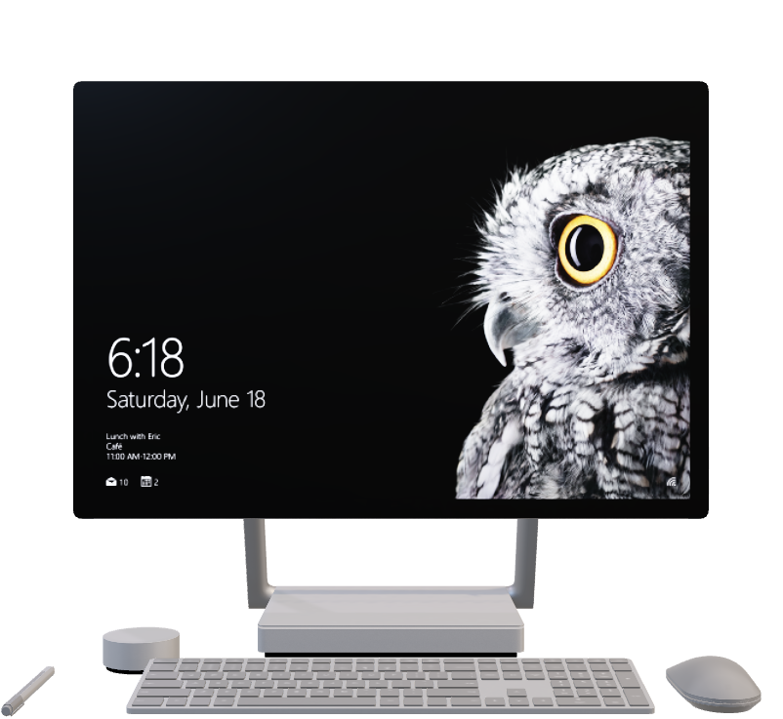
Go to aka.ms/CSUPurviewBootcamp
Verify External Tenant Access
Provision Microsoft Purview (Enterprise) via UI
Deploy Azure SQL DB with sample AdvWorks data via click-2-deploy

